Slide 1
SECURE DATA HIDING IN IMAGES USING STEGANOGRAPHY
PRESENTED BY :
STUDENT NAME : RAJESWAR S S
COLLEGE NAME & DEPARTMENT : K L N COLLEGE OF ENGINEERING, INFORMATION TECHNOLOGY

Slide 2
OUTLINE
Problem Statement
Technology used
Wow factor
End users
Result
Conclusion
Git-hub Link
Future scope

Slide 3
Problem Statement
In the digital era, data security is a major concern due to cyber threats and surveillance. Traditional encryption methods can attract attention, making data a target for attacker. Secure Data Hiding in Images Using Steganography, enhances security by encrypting messages with AES and embedding them in images using LSB steganography. Dual-layer approach ensures both confidentiality and concealment, preventing unauthorized access. A user-friendly web application is developed for easy encoding and decoding of hidden messages.

Slide 4
Technology used
Libraries : Flask, PyCryptodome, OpenCV, hashlib, NumPy, os
Technology & Algorithm : AES (Advanced Encryption Standard), LSB (Least Significant Bit) Steganography, SHA-256 Hashing, Frontend (HTML, CSS)
IDE : Visual Studio Code

Slide 5
Wow factors
AES encryption ensures strong security for hidden messages
LSB steganography minimizes visual distortion in the image
Dual-layer Security, Data is first encrypted before embedding it into an image.
Web-based interface makes encoding and decoding simple and user-friendly
Supports different image formats and automatically converts JPG to PNG
Uses popups to display decoded messages securely

Slide 6
End users
Cybersecurity Enthusiasts & Researchers: For studying secure communication techniques.
Government & Military Organizations: For covert communication without raising suspicion.
Journalists & Activists: To protect confidential information from surveillance.
Corporate Sectors: To securely transmit sensitive business data.

Slide 7
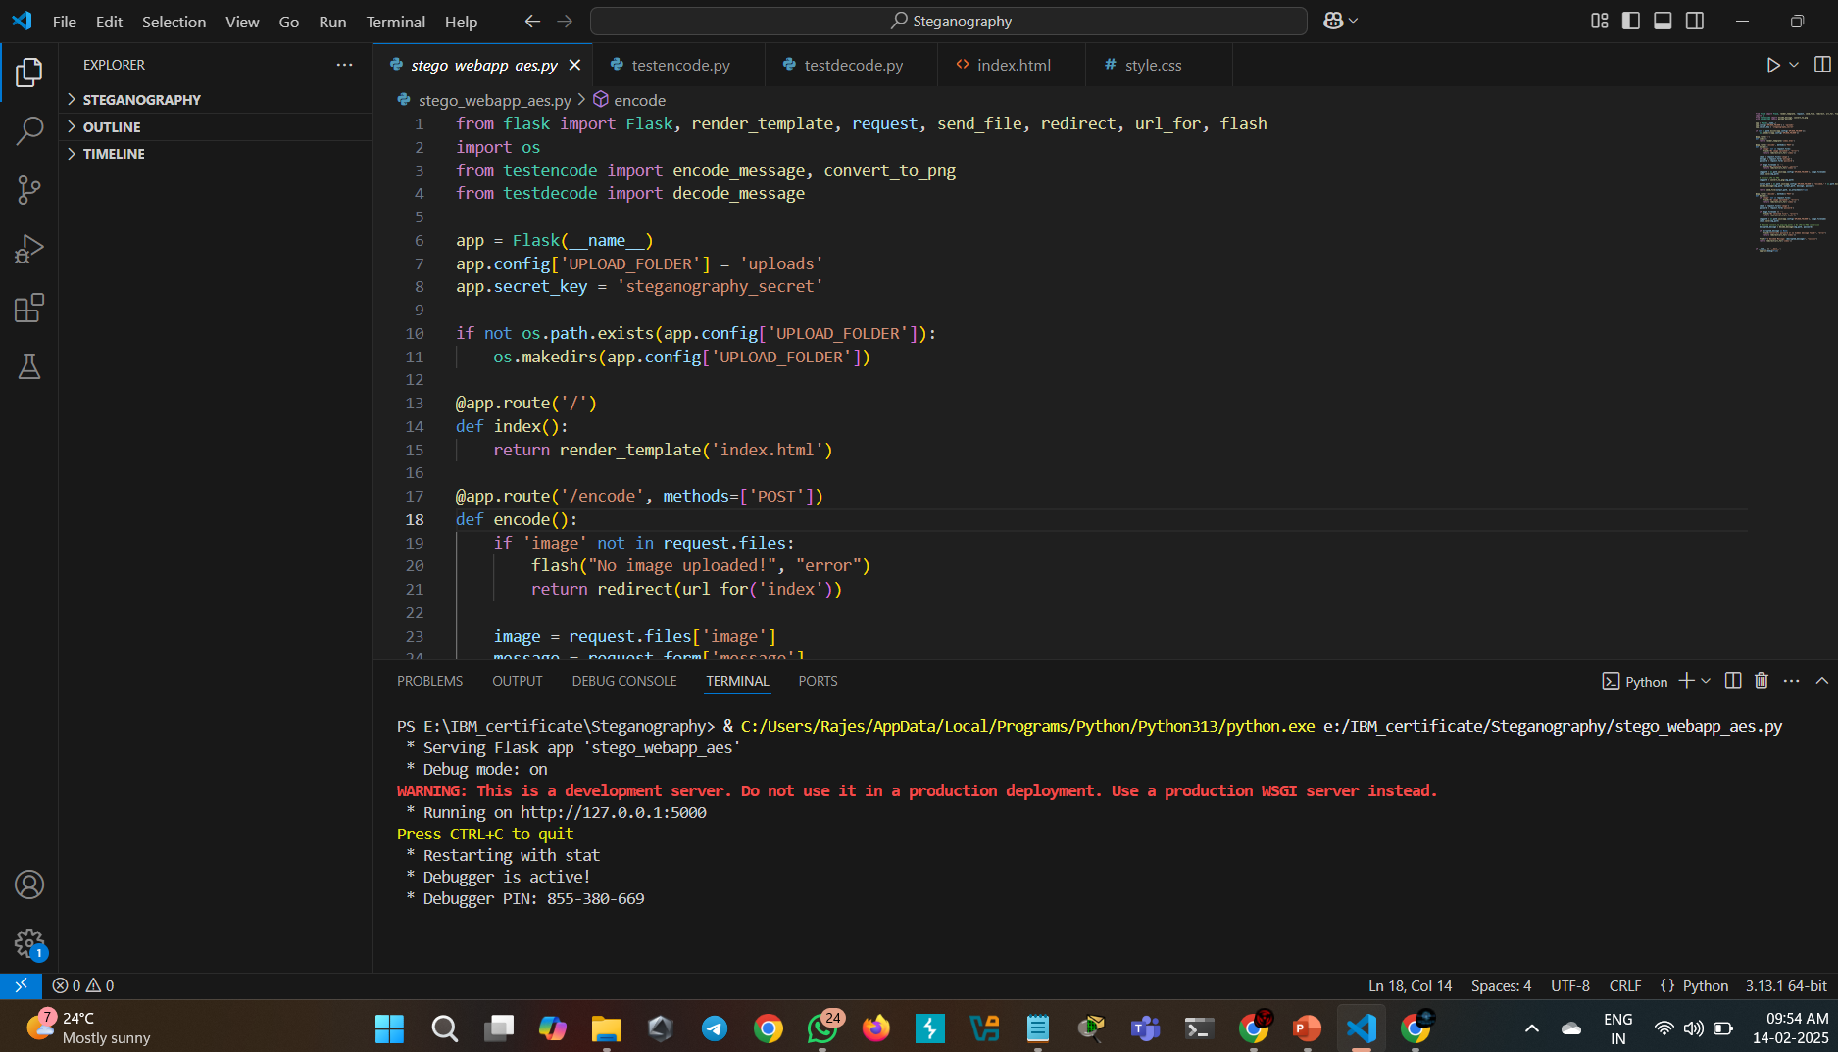
Results
Figure 1.1 Flask server running (stego_webapp_aes.py ) successfully

Slide 8
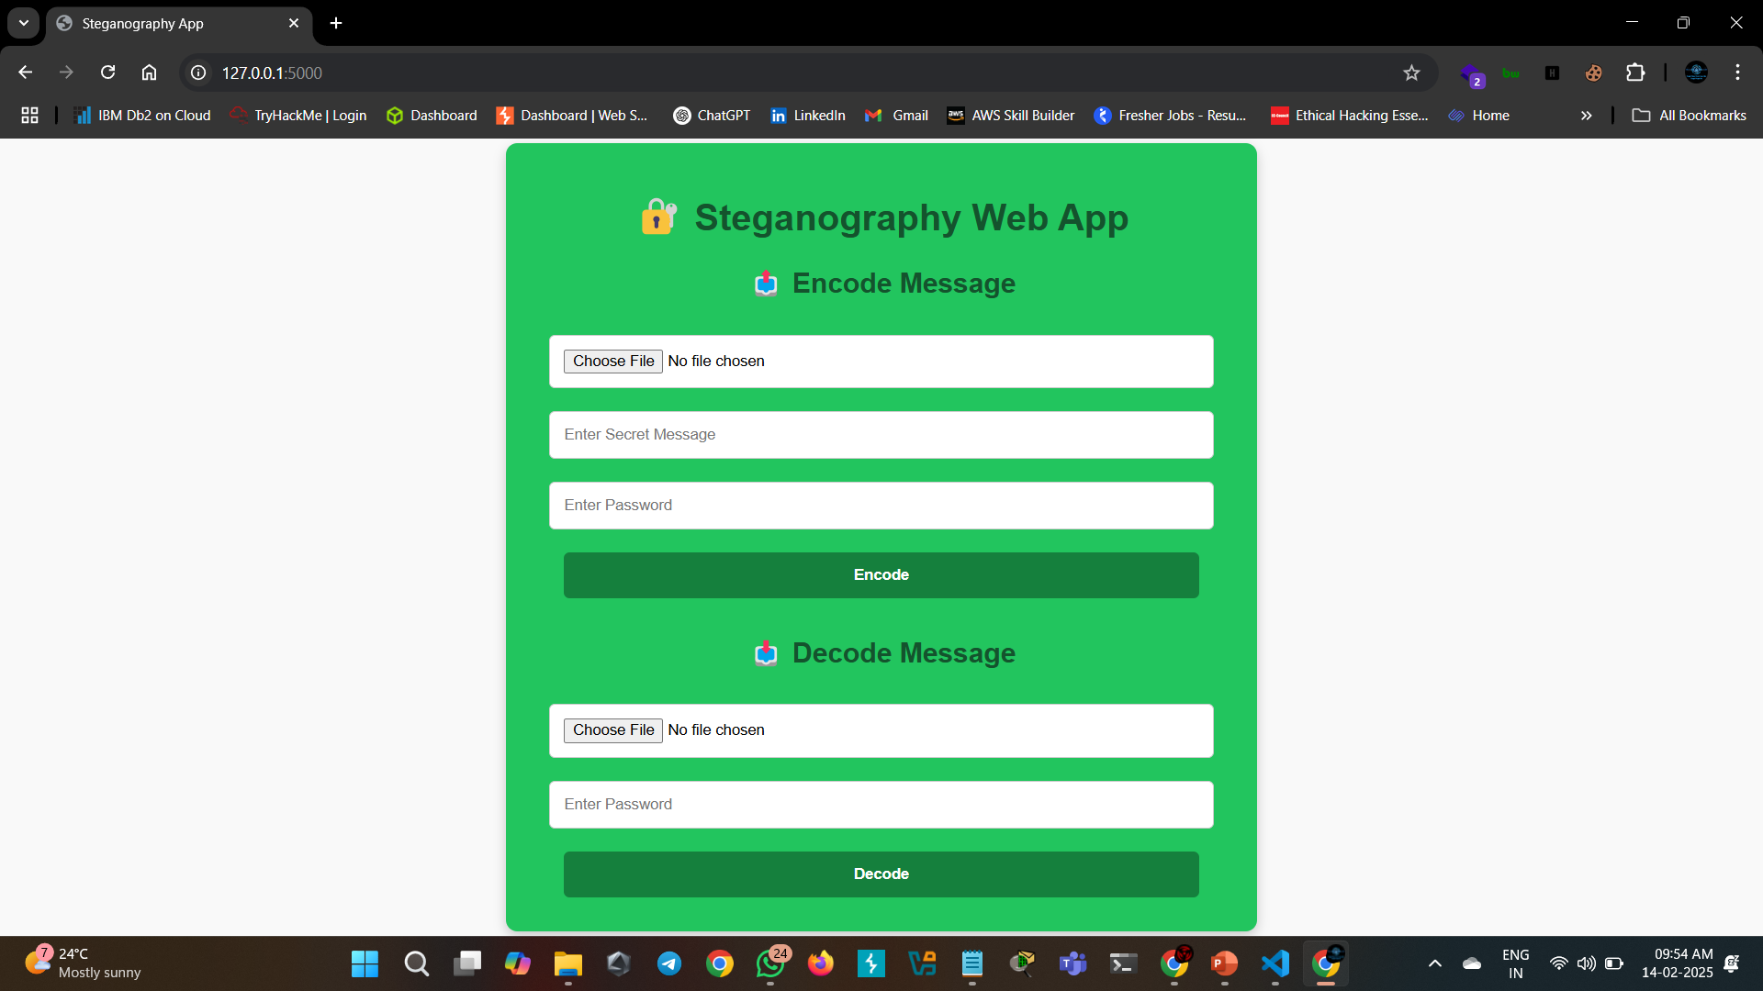
Figure 1.2 Web Interface of Steganography App

Slide 9
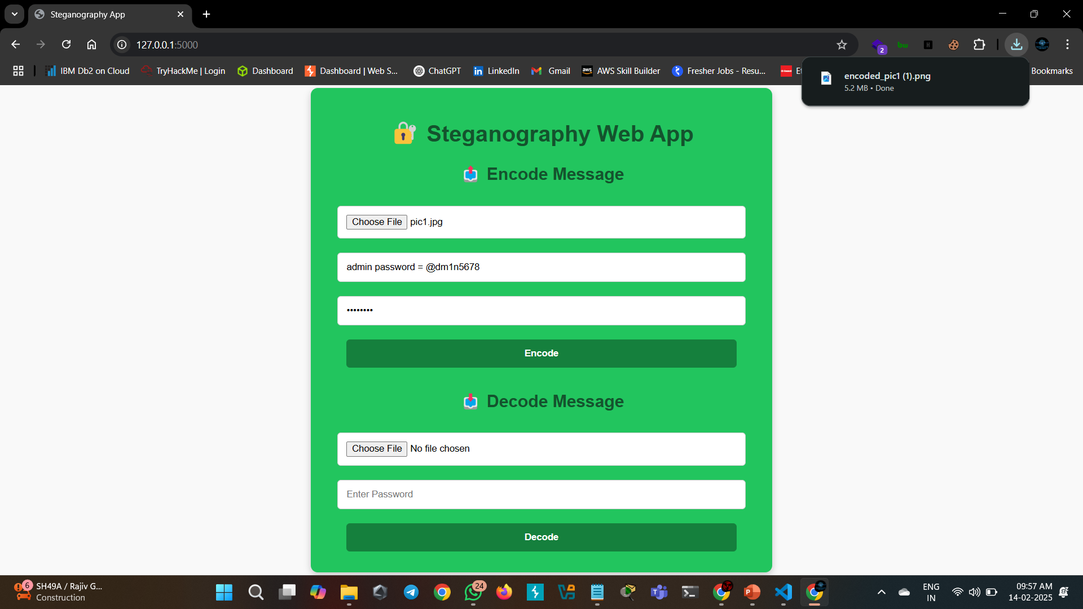
Figure 1.3 – Encoding (User uploads an image, enters a secret message and password, clicks "Encode“ then download the encode image)

Slide 10
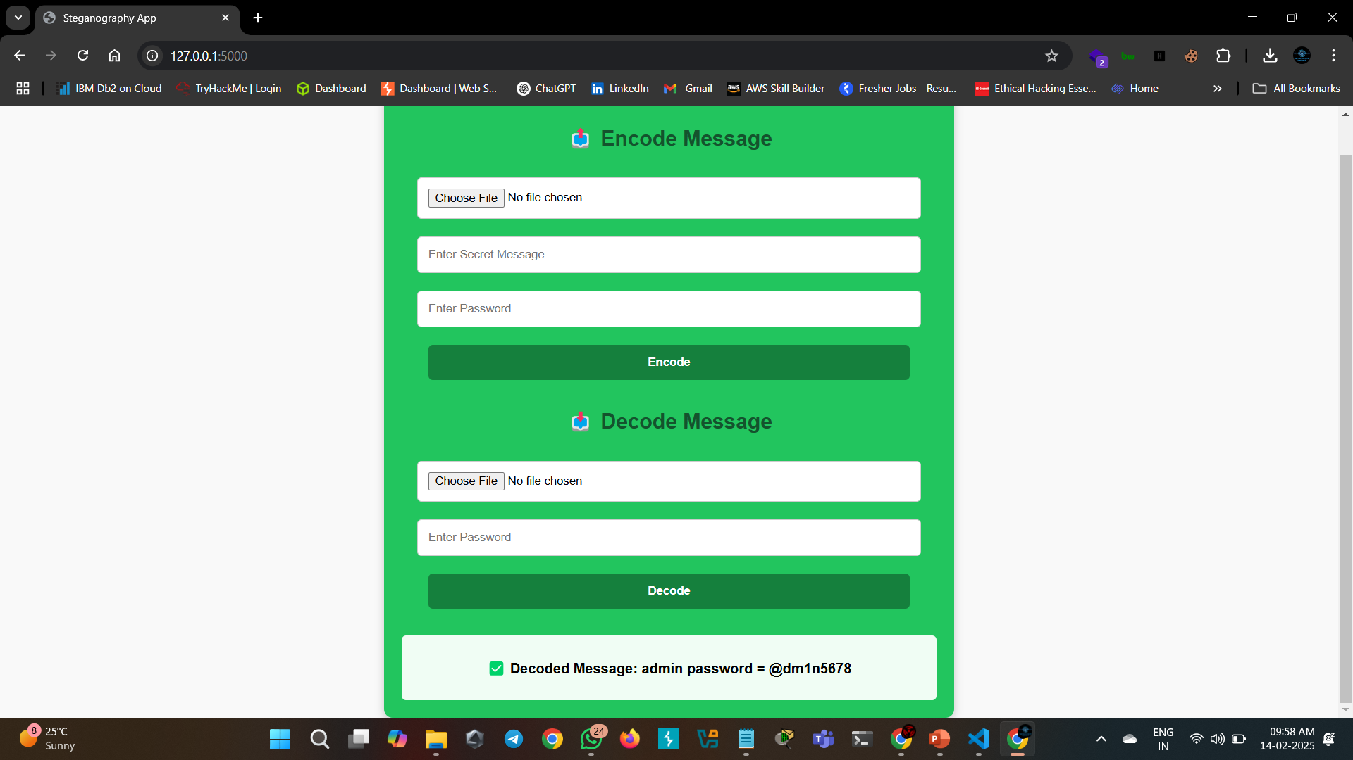
Figure 1.4 Decoded Message Output

Slide 11
Conclusion
Secure data hiding in images ensures confidentiality by combining AES encryption with LSB steganography. The Flask-based web interface simplifies encoding and decoding messages while maintaining password protection. This approach provides a reliable method for secure communication and can be further enhanced with advanced encryption techniques and broader format support.

Slide 12
GitHub Link
SECURE DATA HIDING IN IMAGES USING STEGANOGRAPHY
A secure web application built with Flask that enables users to hide encrypted messages inside images using AES encryption and steganography. The tool allows users to encode and decode messages securely through a web interface.
https://github.com/Rajes-Cyber-Genjutsu/AES-Steganography-WebApp.git

Slide 13
Future scope
Add support for audio and video steganography
Blockchain Integration – Use blockchain for secure key management and authentication.
Mobile & Cloud Integration – Develop a mobile app and integrate with cloud storage for secure access.

Slide 14
THANK YOU

